Slide 1
Data Visualization & Interpretation
Febin.A.Vahab

Slide 2
MATPLOTLIB-VISUALISATION

Slide 3
PLAN
Interactive mode in Matplotlib
Interactive backend
Basic Plots
Lines and Markers
Figures
A complete Example-Stock Data Analysis

Slide 4
MATPLOTLIB
Matplotlib is a Python 2D plotting library which produces publication quality figures in a variety of hardcopy formats and interactive environments across platforms.
“Matplotlib tries to make easy things easy and hard things possible”.
https://matplotlib.org/

Slide 5
Matplotlib Ecosystem
PyData Stack
MATPLOTLIB(Package)
Pandas(Package)
NumPy(Package)

Slide 6
Matplotlib Ecosystem
PyData Stack
MATPLOTLIB(Package)
Pandas(Package)
NumPy(Package)
Pyplot (module)
Pylab (module)
Other APIs

Slide 7
Three Top-level Components
Pylab
Collection of command style functions that make matplotlib work like MATLAB
Frontend
Set of classes that abstract actual plotting mechanics and details using a high-level user API
Backend
Renderers, that transform the frontend representation to hardcopy or a display device

Slide 8
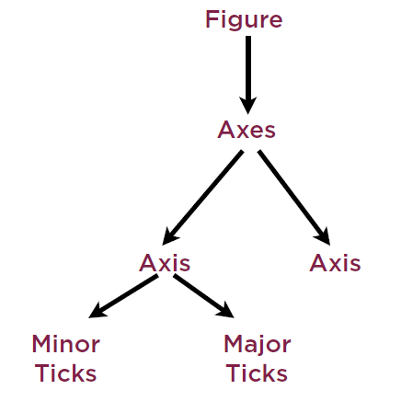
Hierarchy

Slide 9
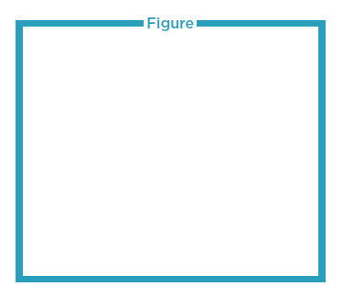
Hierarchy
Overall window or page, within which all operations are performed

Slide 10
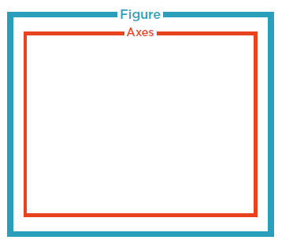
Hierarchy
Area within a figure where actual graphs are plotted

Slide 11
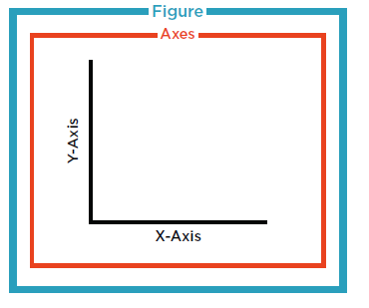
Hierarchy
Axes has an X-Axis and a Y-Axis

Slide 12
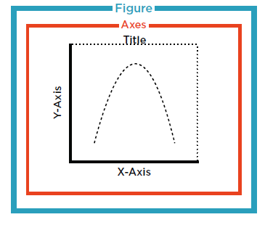
Hierarchy
Contains ticks, tick locations, labels

Slide 13
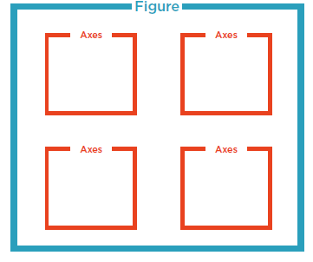
Hierarchy
A figure can have more than one axes

Slide 14
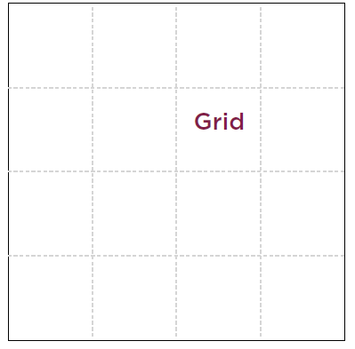
Anatomy of a figure

Slide 15
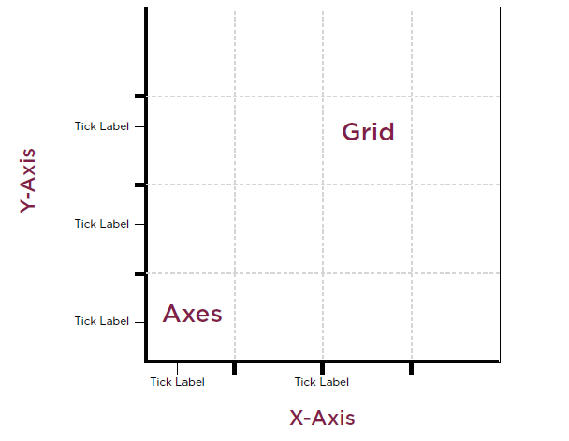
Anatomy of a figure

Slide 16
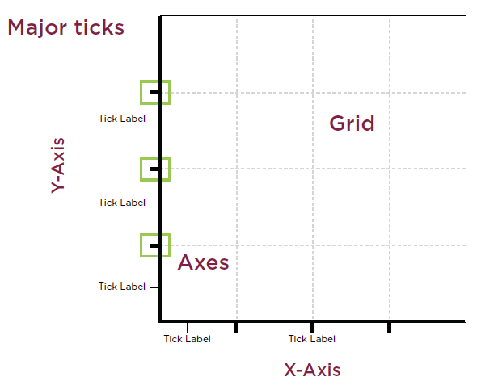
Anatomy of a figure

Slide 17
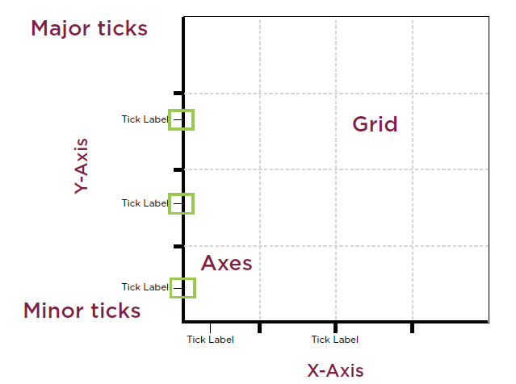
Anatomy of a figure

Slide 18
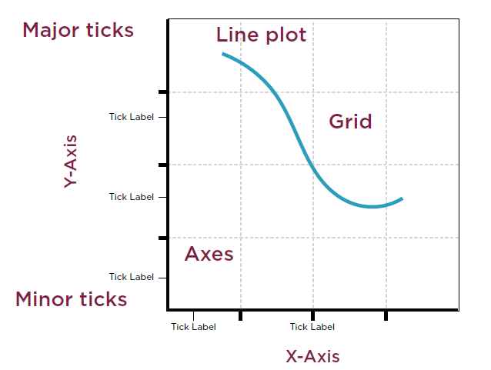
Anatomy of a figure

Slide 19
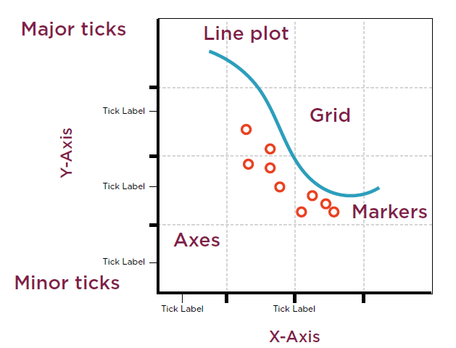
Anatomy of a figure

Slide 20
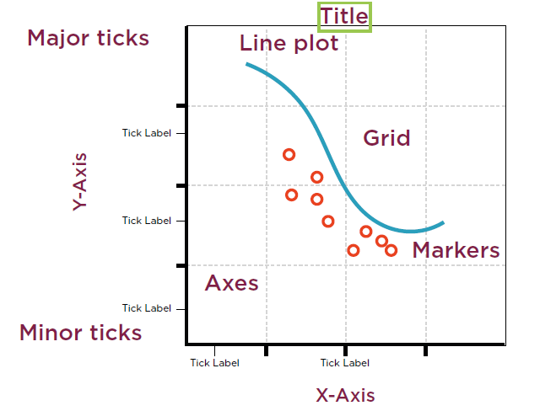
Anatomy of a figure

Slide 21
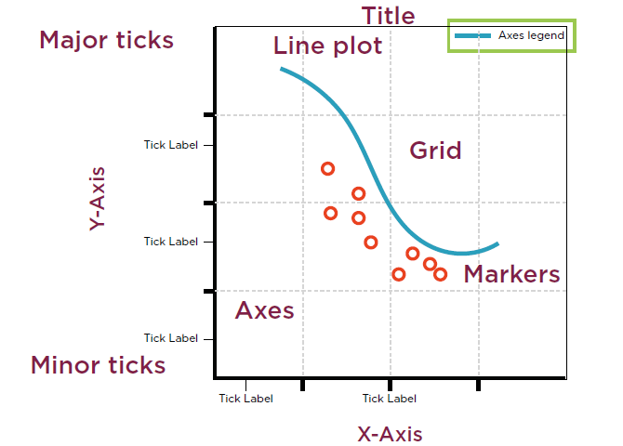
Anatomy of a figure

Slide 22
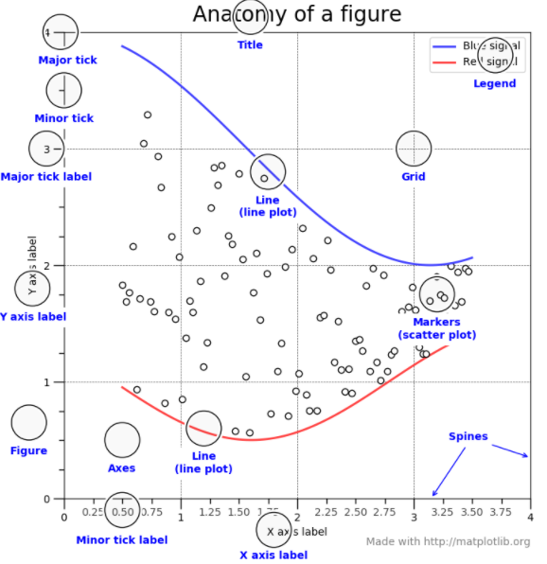
Anatomy of a figure

Slide 23
Thank You!

